Slide 1
ENG111
Chapter 1: Communication
Shahneela Tasmin Sharmi (STS1)

Slide 2
Introduction
Communication is a complex process through which we express, interpret, and coordinate messages with others to create shared meaning, meet social goals, manage personal identity, and carry out our relationships.
Messages are the verbal utterances, visual images, and nonverbal behaviours used to convey thoughts and feelings.

Slide 3

Encoding
Decoding
Feedback
Encoding refers to the process of creating messages
Decoding refers to the process of interpreting messages
Feedback occurs when someone reacts or responds to the messages received.
Upon receiving feedback, a person may adjust his or her behavior based on that feedback. This is called interaction coordination.

Slide 4

A canned plan is a “mental library” of scripts each of us draws from to create messages based on what worked for us or others in the past.
A script is an actual text of what to say and do in a specific situation.
We develop canned plans and scripts from our own previous experiences and by observing what appears to work for other people.
We use these for our interactions, such as greetings.

Slide 5
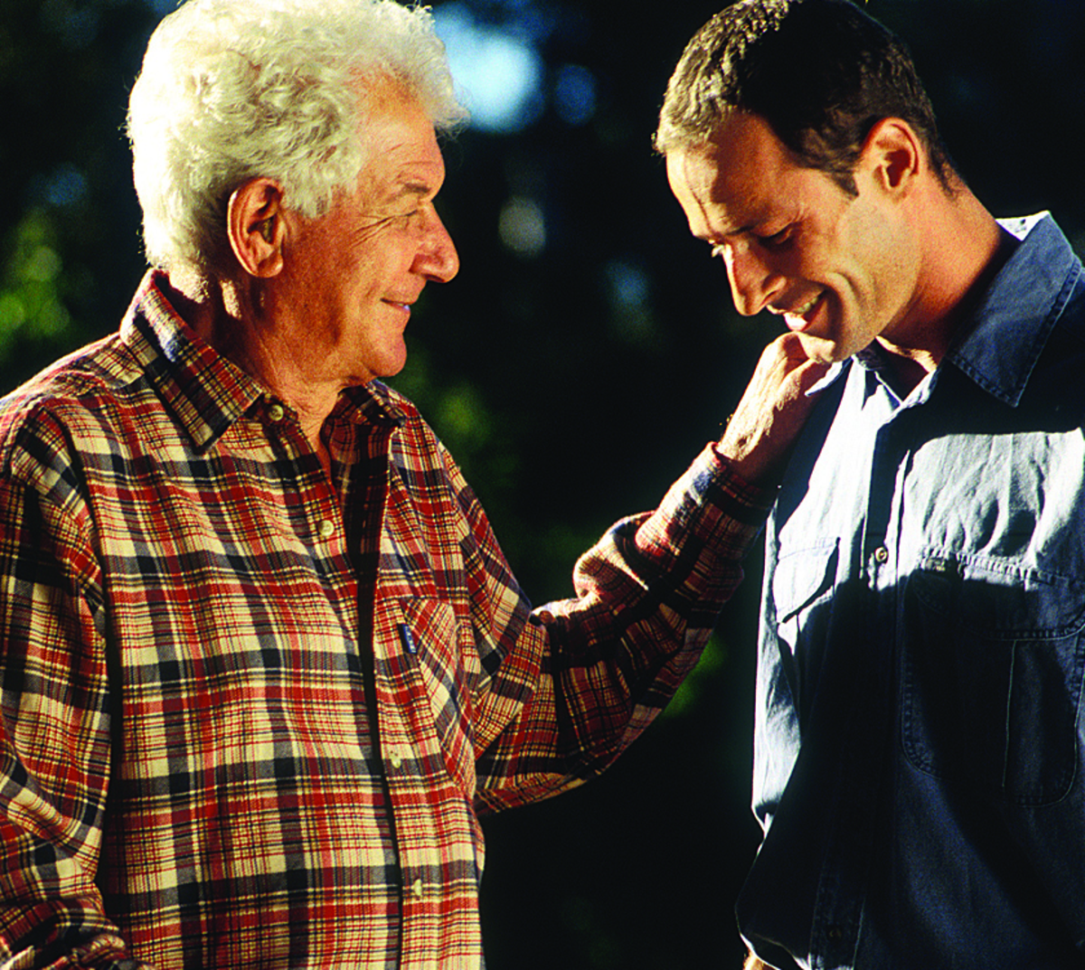
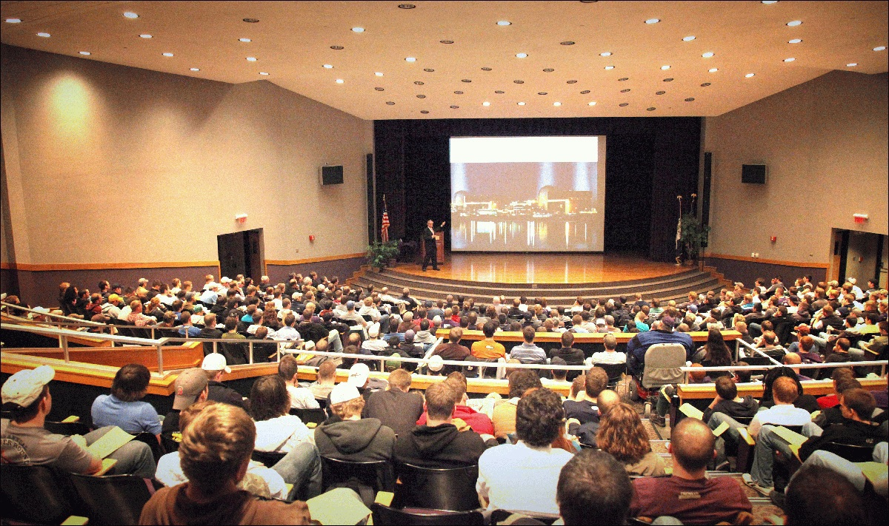

Communication setting: Communication settings differ based on the number of participants and the level of formality in the interactions.
Intrapersonal communication | Interactions with own self
Interpersonal communication | Interaction between two people
Small-group communication | Interaction with a group of 20 people or less
Public communication | Interaction with a group of more than 20 people
Mass communication | Using the media to reach a large part of the population
This Photo by Unknown Author is licensed under CC BY-SA

Slide 6
Principles of communication
Communication has a purpose
Define sense of self
Meet our social needs
Develop and maintain relationships
Exchange information
Influence others
Communication is continuous (includes nonverbal communication)
Communication messages may change based on conscious thought, i.e. a message may result from a spontaneous expression of feeling or may be heavily constructed.
Communication is relational

Slide 7
Principles of communication
Communication is guided by culture
Communication has ethical implications
Communication is learned
Culture is a system of shared beliefs, values, symbols and behaviours

